Slide 1
Repetition & Textures
Seeing it Over and Over Again

Slide 2
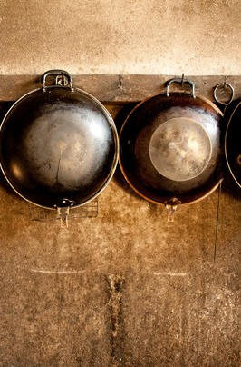
Repetition
The occurance of strong elements happening in multiple places/ways in your photograph.
Common Repeating Elements???
Color
Shape
Lines

Slide 3
The Music Rhythm of Patterns
*Do not write in Notes
“Patterns are to photography, what Rhythm is to music. Without the limitation of just a single point of interest, repetition helps your eye dance from point to point with pure delight. You are not asked to make a judgment of the subject, simply to explore it. Like music, you are not expected to just listen to a single note, but to take in the high notes, low notes, the movements, and the beat. The goal here is not to just witness a good photograph, but to experience it. Thus, when repetition is used correctly . . . it can greatly increase the emotional impact of your images.”
~ Tedric A. Garrison
http://www.picturecorrect.com/tips/repetition-and-patterns-in-photography/

Slide 4
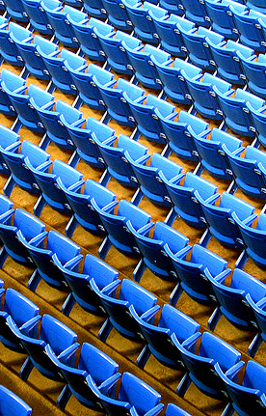
Patterns
When multiple repeating elements form a strong visual statement in your photograph.
Often used for calm, peaceful, easy photographs
Where are some repetition/pattern elements in our
class/school?

Slide 5
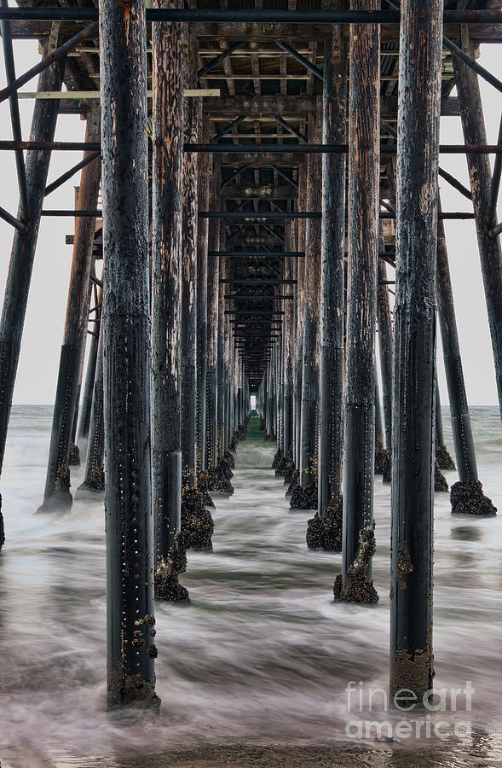
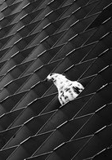
Using Repetition
Emphasize It OR Break It

Slide 6

Emphasize It
Fill Frame with Object
Burst Out of Frame Edges
Use photographer position & camera angles to create.
This provides calm

Slide 7
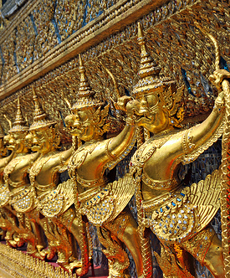
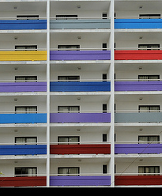
More Emphasized Pattern

Slide 8
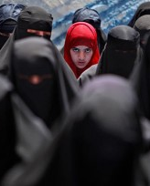

Break It
Fewer “Break” Elements means more drama
Super-Emphasizes subject matter
Can consist of multiple element breaks (i.e. color break, line break, shape break)
Point out examples of pattern breaks in the classroom

Slide 9
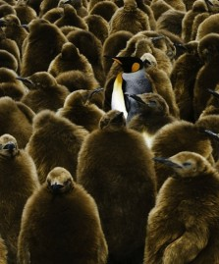
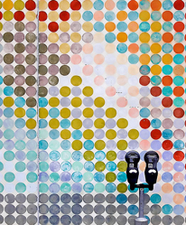
More Broken Patterns

Slide 10

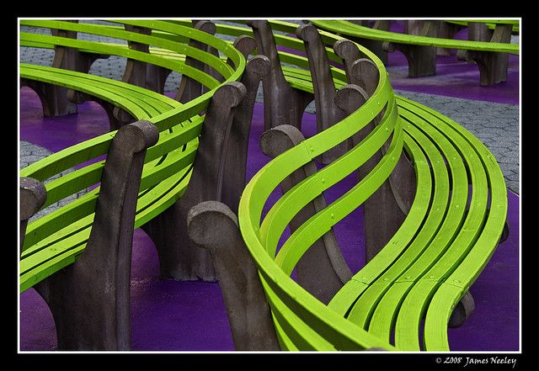
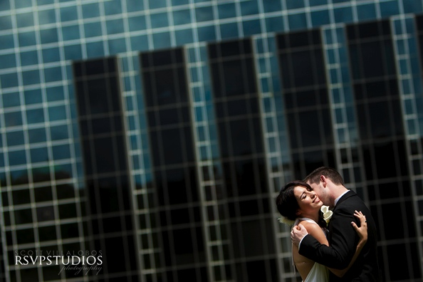
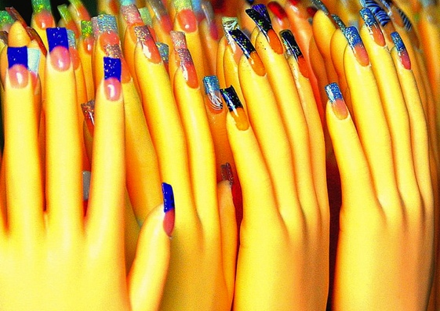
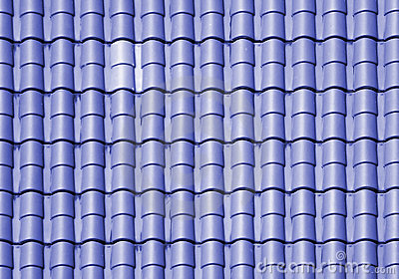
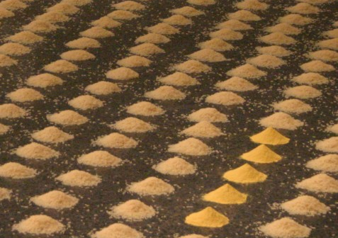
Patterns Summarized
Useful to “enhance” photograhs”
Careful of Over-Use
Maximum success requires Detailed Composition

Slide 11
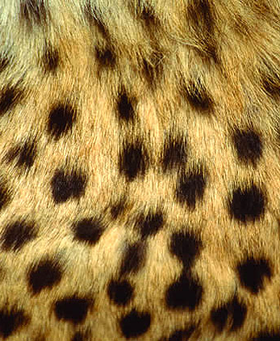
Texture
Increases effect of other elements of the shot
Can provide own story

Slide 12
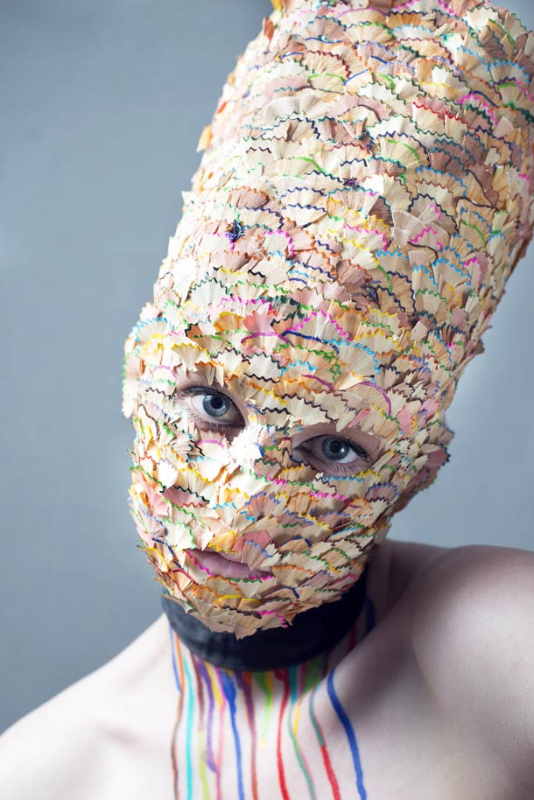
3 Elements of Texture
Contrast
Curves
Patterns

Slide 13
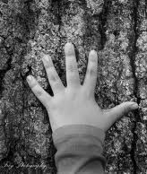
Contrast
Key aspect of Texture
Determines the depth/range of the texture
Focus on lighting and camera angle

Slide 14
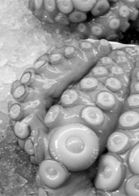
Curves
Provide changes in tonal range and lead to subject
Curves should work in harmony with the intent of the photograph

Slide 15
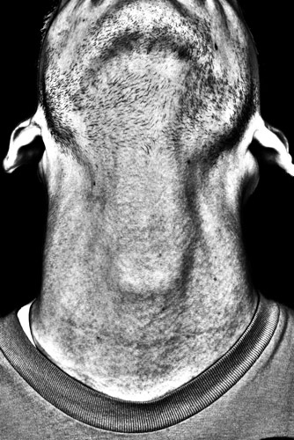
Patterns
See previous slides

Slide 16
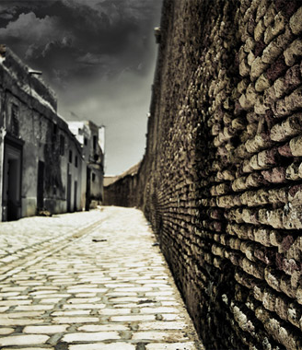
Textures Abound
List the different Hallway textures in Hutch
List the different lighting conditions of Hutch
Other Texture Rich Targets?

Slide 17

Questions

Slide 18
References
http://www.picturecorrect.com/tips/texture-in-photography/

