Slide 1
BEATing the News
The In’s and Out’s of Beat Reporting

Slide 2
What’s a Beat?
Definition: The subject area that a reporter is assigned to cover.
“Beat reporters” can cover everything from local crime to a specific sports team. (Hence the term “working a beat.”)

Slide 3
Four Steps to Effectively Covering a Beat
Blast the Beat
Learn the Subject
Meet the Players
Build Trust
Relate to Readers
http://journalism.about.com/od/reporting/a/beat.htm

Slide 4
Learn the Beat
Read
Research
Live
View
Read

Slide 5
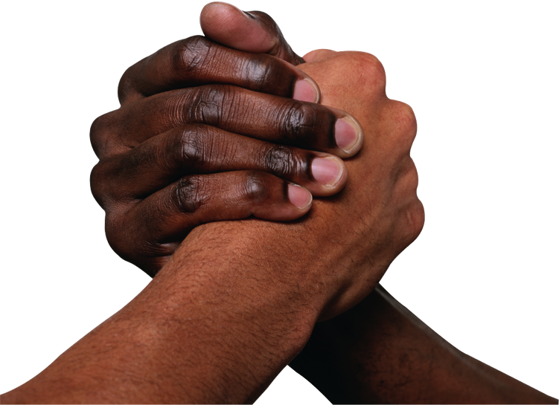
Meet the Players & Get Contacts
Meet everyone involved
Don’t forget support staff
Develop Rapport with a few as “Sources”
Schmooze or Lose

Slide 6
Relate to Readers/Viewers
Never Assume
Remember your Roots
Teach your viewer

Slide 7
Sample Beats
Local
State
Weather
Sports
More?
Sample Vid 1
Sample Vid 2
Sample Vid 3
Sample Vid 4

